Slide 1
Model-Free Learning Example
In a model-free approach, the agent does not care about the underlying "why" or the specific probability
distributions of the machines. It simply maps actions directly to expected rewards based on experience.
The Logic: "When I pulled Arm A, I got 10 points. I'll increase my 'score' for Arm A.”
The Tool: Action-Value Methods (greedy method).
The Process:
The agent maintains an estimate $Q(a)$ for each arm.
It pulls Arm A and receives reward $R$.
It updates the value using a simple error correction formula:
Q_{new}(A) → Q_{old}(A) + α[R - Q_{old}(A)]
The agent chooses the next arm based solely on which $Q$ value is currently highest (with occasional random exploration).
Analogy: You go to a restaurant and try the pasta. It’s great, so you give the restaurant a "5-star"
rating in your head. You don't know the recipe or who the chef is; you just know "Pasta = Good."

Slide 2
Q learning
Q-Learning is a popular model-free reinforcement learning algorithm that helps an agent learn how to make the best decisions by interacting with its environment. Instead of needing a model of the environment the agent learns purely from experience by trying different actions and seeing their results.
How is this Quality measured ?
In Q-learning, “quality” refers to how good a particular action is in a given state—i.e., how much long-term reward the agent expects if it takes that action and then follows the best policy afterward.

Slide 3
Q learning
The goal of Q-learning is to learn an optimal policy that tells an agent what action to take in each state so that it maximizes cumulative future reward.
Where,
S is the current state.
A is the action taken by the agent.
S' is the next state the agent moves to.
A' is the best next action in state S'.
R is the reward received for taking action A in state S.
γ (Gamma) is the discount factor which balances immediate rewards with future rewards.
α (Alpha) is the learning rate determining how much new information affects the old Q-values.

Slide 4
What is the difference between Value iteration and Q learning ?
Concept | Value Iteration | Q-Learning
Learns | V(s) | Q(s,a)
Needs model | Yes – [Transition function] MDP, POMDP ? | No [Transition function]
Chooses action directly | No | Yes
Exploration, Exploitation | No | Yes
Equation | V∗(s)=max_{a}​[R(s,a)+γ∑_{s′​}P(s′∣s,a)V∗(s′)]

Slide 5
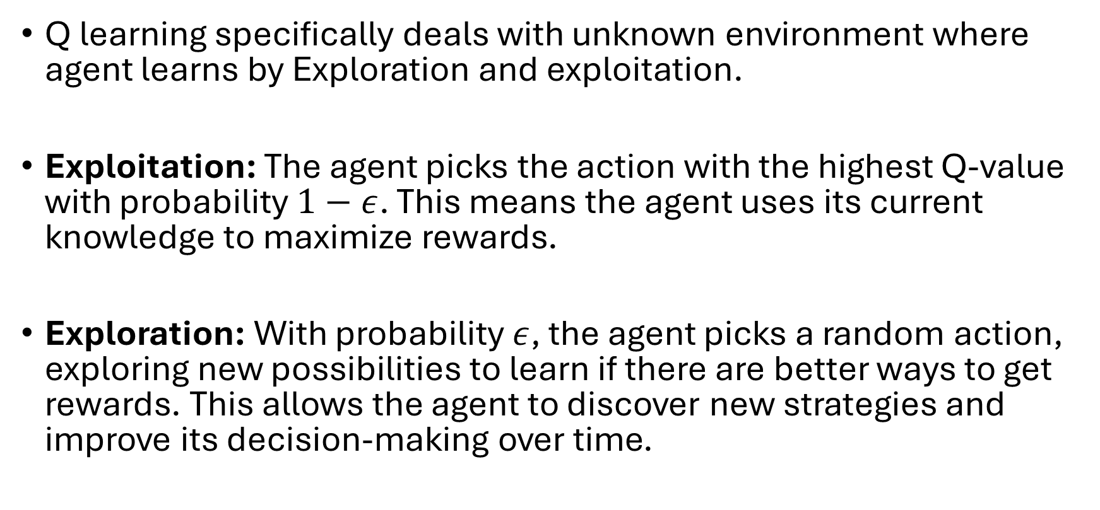
Q learning
Q learning specifically deals with unknown environment where agent learns by Exploration and exploitation.
Exploitation: The agent picks the action with the highest Q-value with probability $1−ε$. This means the agent uses its current knowledge to maximize rewards.
Exploration: With probability $ε$, the agent picks a random action, exploring new possibilities to learn if there are better ways to get rewards. This allows the agent to discover new strategies and improve its decision-making over time.

Slide 6
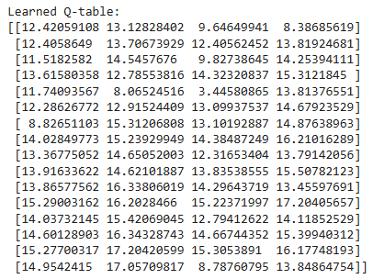
Q learning table
Each row index (0–15) represents a state in the 4×4 grid.
Each column value shows the Q-value for the actions [Left, Right, Up, Down].
Higher Q-values indicate better actions that move the agent closer to the goal.
For instance:
In the last few rows (states 12–15), the Q-values are noticeably higher. This means the agent has learned that these states are near the goal state (15) and should move toward it.
The top rows (states 0–3) have lower Q-values, showing that those positions are far from the goal and require more steps to reach it.
The agent’s policy i.e. best action from each state would be the action corresponding to the maximum Q-value in that row. Expensive in Some Environments: In robotics, testing actions can be costly due to physical limitations.

Slide 7
Q learning
So, after x no of episodes, Q-table reflects the final learned values after all updates.
Continuously updated, no reset
Each episode adds experience
Table adapts gradually
Episodes vs Steps
Episode: a complete run of the agent from start to a terminal state.
Step: a single state-action transition within an episode.
If your environment is very short and every episode passes through all 6 states exactly once, then yes, you could roughly do 500×6=3000 Q updates.

Slide 8
Why Q table”s goal state has lesser value than previous states sometimes
This happens for mathematical and modeling reasons, not because the algorithm is wrong.
The goal state usually has no future reward.
Terminal state has no value.
Terminal state = end of episode, No future learning happens there. So its Q-values stay low or zero.

Slide 9

SARSA
“Since I might take bad/random actions, I should learn values that reflect that risk”
More conservative approach than Q learning !!!
Usually more stable than Q learning.
Similar applications to that of Q learning.
Program ?

Slide 10
Q learning Exploration is neglected ?
Exploration happens in behavior. BUT is ignored in learning – as always inclined towards acting optimally.
Fixed Exploration Rate: A fixed epsilon doesn't adapt. Ideally, the agent should explore a lot initially and then exploit more as it becomes confident in its knowledge of the environment.
Lack of State-Specific Exploration: Epsilon-greedy explores all states equally. Some states might be visited very rarely, and the Q-values for those states will remain inaccurate. More advanced methods encourage visiting less-known states explicitly.
Decaying Epsilon impact ?
Deep Q ? → scalability

Slide 11
The Cliff Problem
The Setup (Cliff World)
Imagine a grid:
Start at one corner
Goal at another
Along the bottom edge is a “cliff”
If the agent steps into the cliff → huge negative reward (like -100) and resets
Key Difference in Simple Words
Q-learning (Greedy, Risky) : Learns the best possible path, assuming perfect decisions. It does NOT care about mistakes during learning.
Result: Chooses the path right next to the cliff (shortest path).
Problem: If the agent makes even a small mistake → falls off the cliff.
SARSA (Cautious, Realistic) Learns based on what it actually does (including exploration mistakes)It accounts for risk.
Result: Chooses a safer path away from the cliff
Benefit: Even if it explores randomly, it avoids catastrophic penalties

Slide 12
Multi Agency in Reinforcement learning
MASARSA , Multi agent Q learning.
Cooperation vs. Competition
Information gain or Convergence ?
Update Mechanism ?
Social Agency ?

Slide 13
Plan Ahead
Revise AI agency in terms of RL – Thursday
Doubt clearing going over Assignment 2, Project Details – coming Tuesday, may be Assignment 3 if time permits
Other AI agency concepts ?
Prompt engineering : Token summarization
Basics of Retrieval-Augmented Generation (RAG)
Agent workflows – may be valuable for project implementation
LLMs

